Slide 1
Data Analysis of Diamonds Dataset
Distribution and Relationship Analysis
ATTIPOE THYWILL E. & JUANITA AD

Slide 2
INTRODUCTION
The purpose of the study is to determine the price of diamond considering it’s features.
The features of Diamonds are identified in the data as 17. These are Shape, Cut, Colour, Clarity Carat Weight, Length/Width Ratio, Depth %, Table %, Polish, Symmetry, Girdle, Culet, Length, Width, Height, Price, Type, Fluorescence

Slide 3
Introduction
Objective: To analyze the diamonds dataset
to understand:
-Distributions of key numeric variables
- Relationships between carat weight, price, and other features
- Correlations among numeric attributes

Slide 4
Dataset Overview
Dataset contains 6,485 rows and 18 columns.
Key columns include:
- Numeric: Carat Weight, Length/Width Ratio, Depth %, Price, etc.
- Categorical: Shape, Color, Clarity, Type, etc.
- Target variable: Price (numeric).

Slide 5
Data Cleaning
Data cleaning steps included:
- Handling missing values (e.g., Cut, Polish, Symmetry).
- Verifying data consistency and structure.
- Preparing numeric and categorical columns for analysis.

Slide 6
Three variables in the data namely culet, cut, fluorescence have extremely high values which makes them outliers.
In other to correct this anomaly we used a series of processes in Kramer's correlation to identify the importance of each variable to price.

Slide 7
Distribution Analysis
We conducted an analysis of the distributions of numeric columns, including:
- Carat Weight
- Price
- Length/Width Ratio
- Depth %, Table %, and more.
Refer to the graphics below

Slide 8
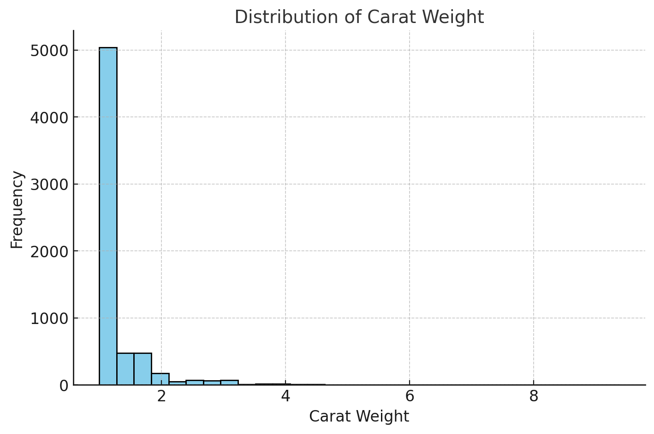
Distribution of Carat Weight:
FIG. 1
Distribution of Carat Weight: The carat weight distribution shows that most diamonds are small in size, with a significant number of them weighing less than 1 carat. A few diamonds weigh more than 2 carats, indicating a skewed distribution.

Slide 9
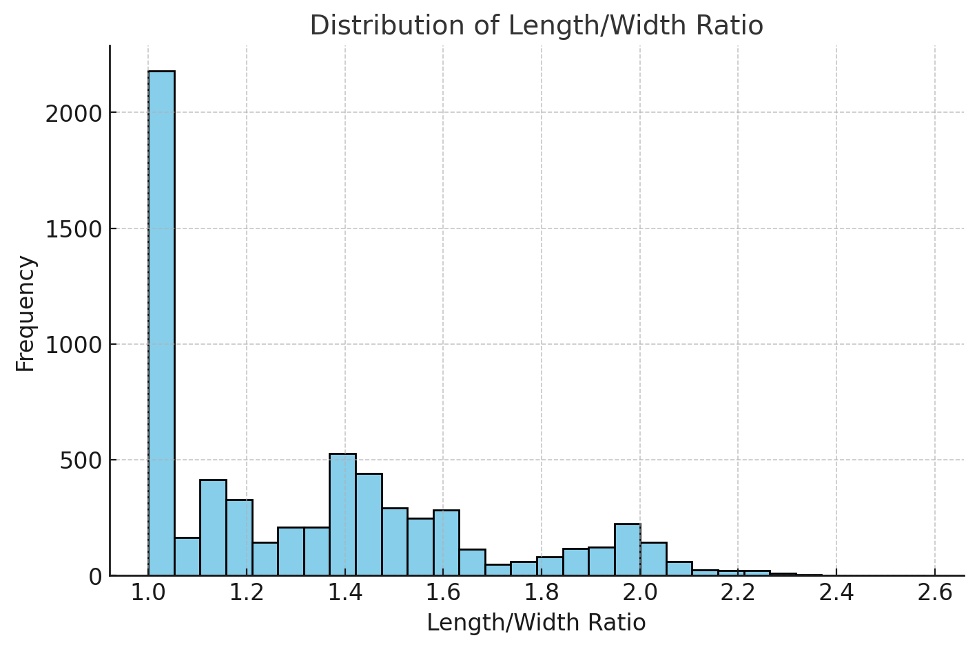
Distribution of Length/Width Ratio
FIG. 2
Distribution of Length/Width Ratio: This ratio indicates the shape of the diamond. Most diamonds have a ratio close to 1.0, which suggests they are more square or round. Ratios above 2.0 represent elongated shapes, which are rare.

Slide 10
Distribution of Depth %:
FIG. 3
Distribution of Depth %: The depth percentage represents the depth of a diamond relative to its width. The distribution peaks around 60%, a common ideal depth percentage for diamonds to balance appearance and weight.

Slide 11
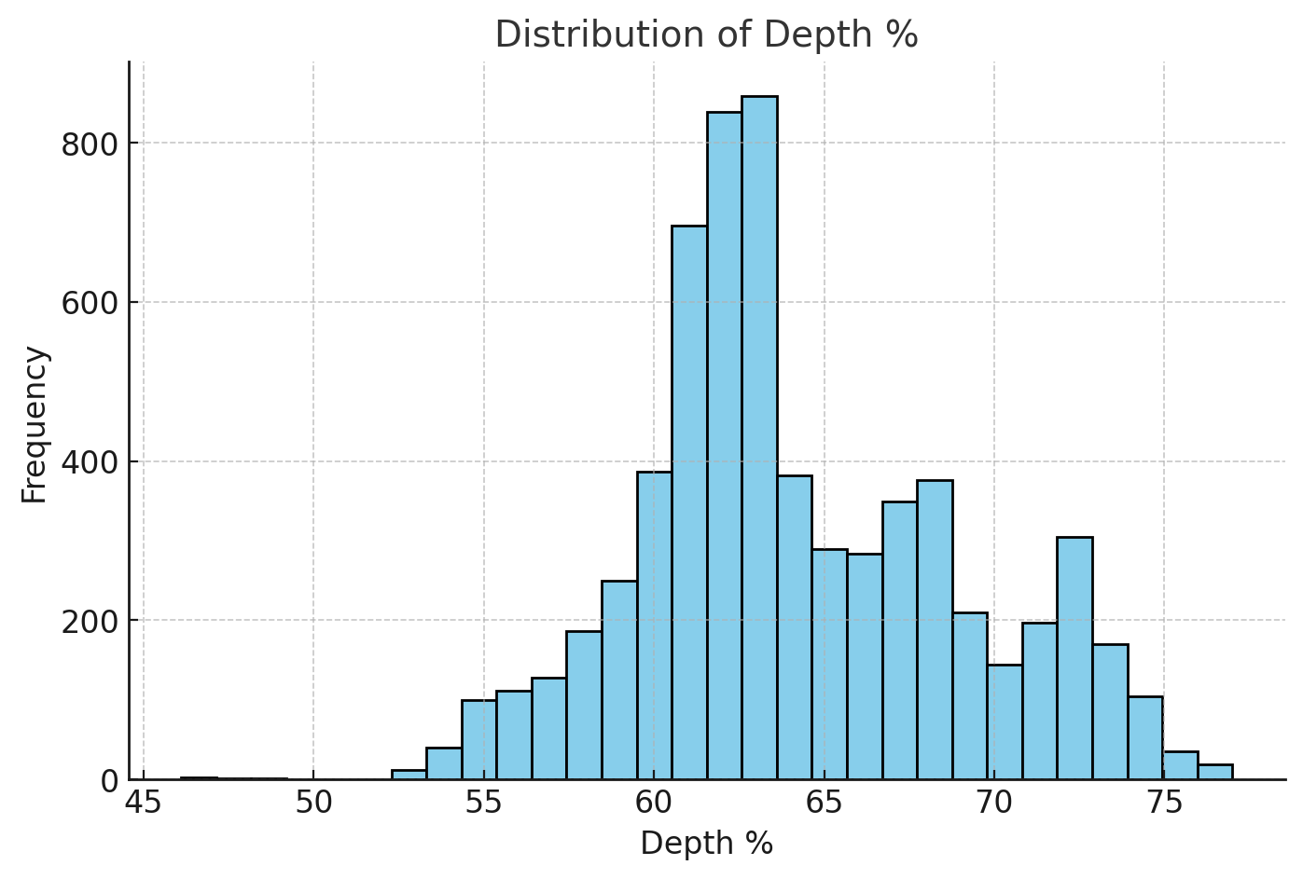
Distribution of Width %:
FIG. 4
Distribution of Width %:The table percentage is the width of the diamond's top facet relative to its width. The distribution peaks around 60%, with some diamonds having higher or lower percentages.

Slide 12
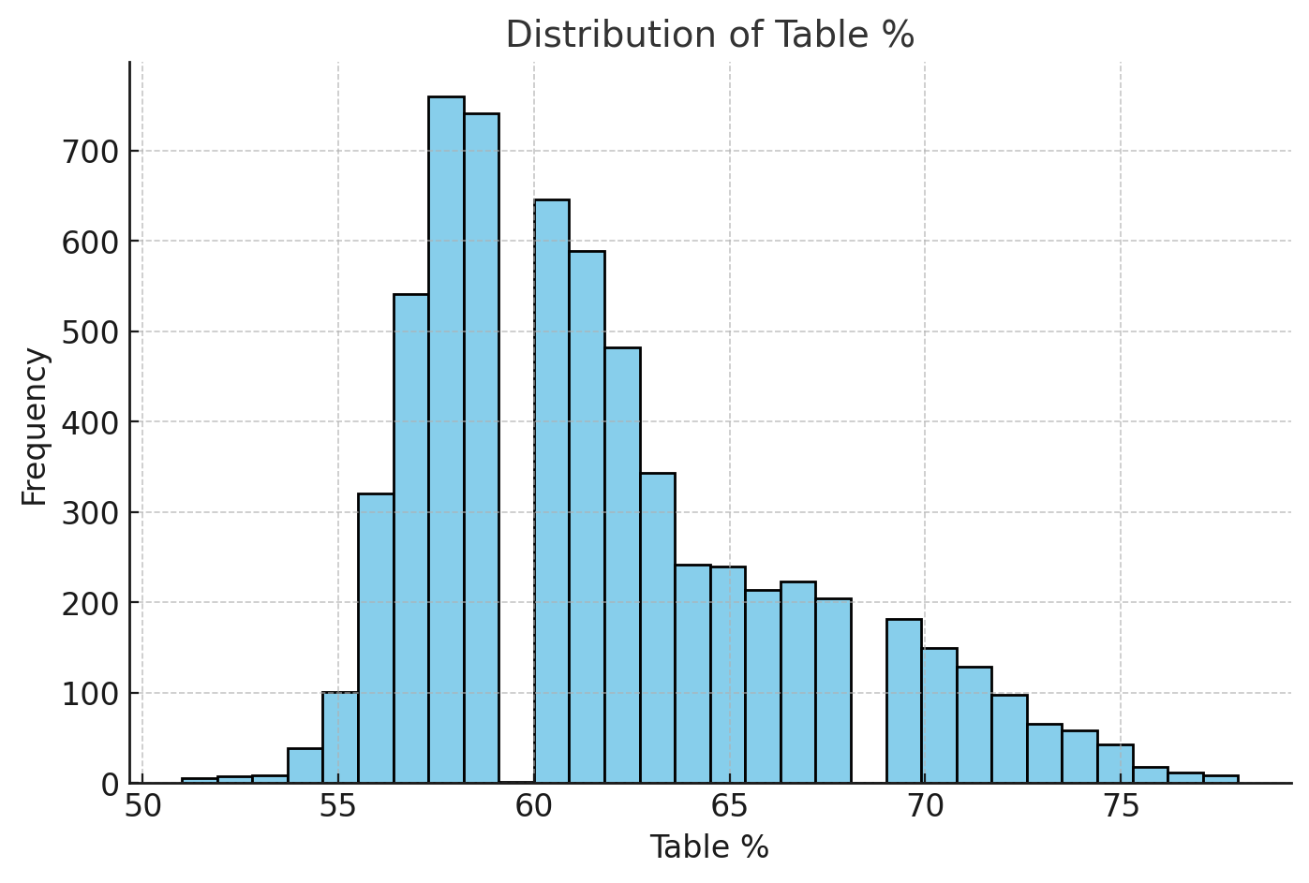
Distribution of Length
FIG. 5
Distribution of Length :The length of diamonds varies widely, with most being between 6 and 8 mm. Longer diamonds are less common, suggesting unique cuts or shapes.

Slide 13
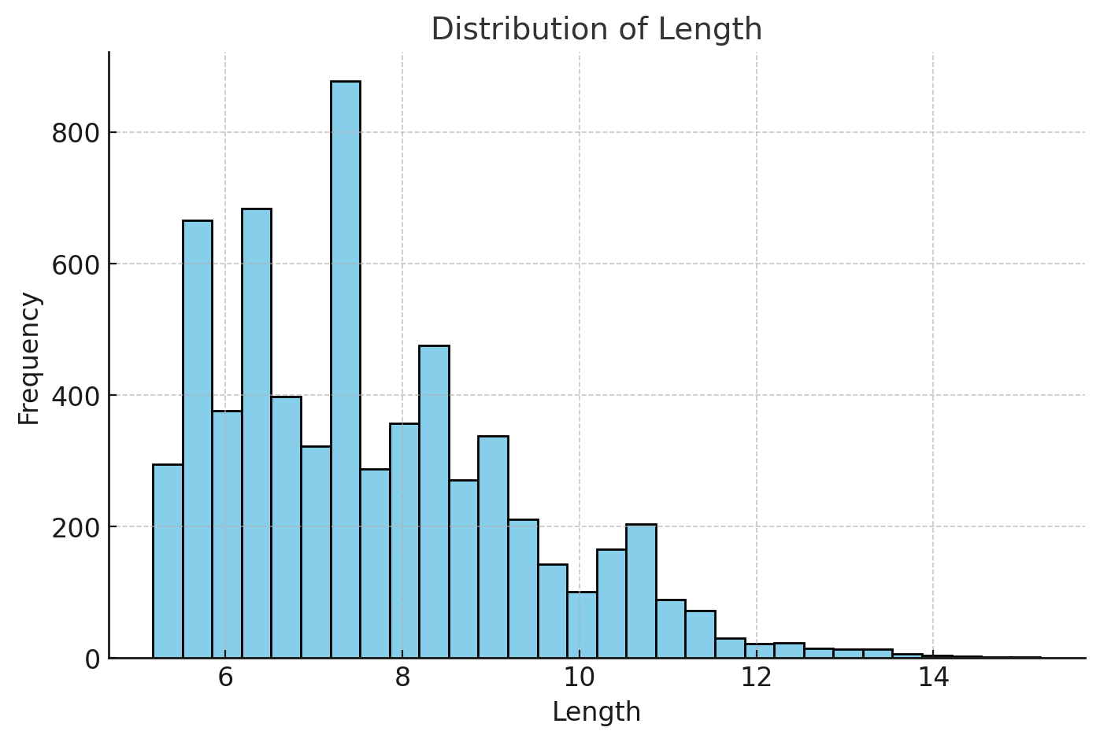
Distribution of Width
FIG. 6
Distribution of Width:
The width of diamonds follows a similar trend to length, with most values between 5 and 7 mm. Width directly influences the overall appearance of the diamond

Slide 14
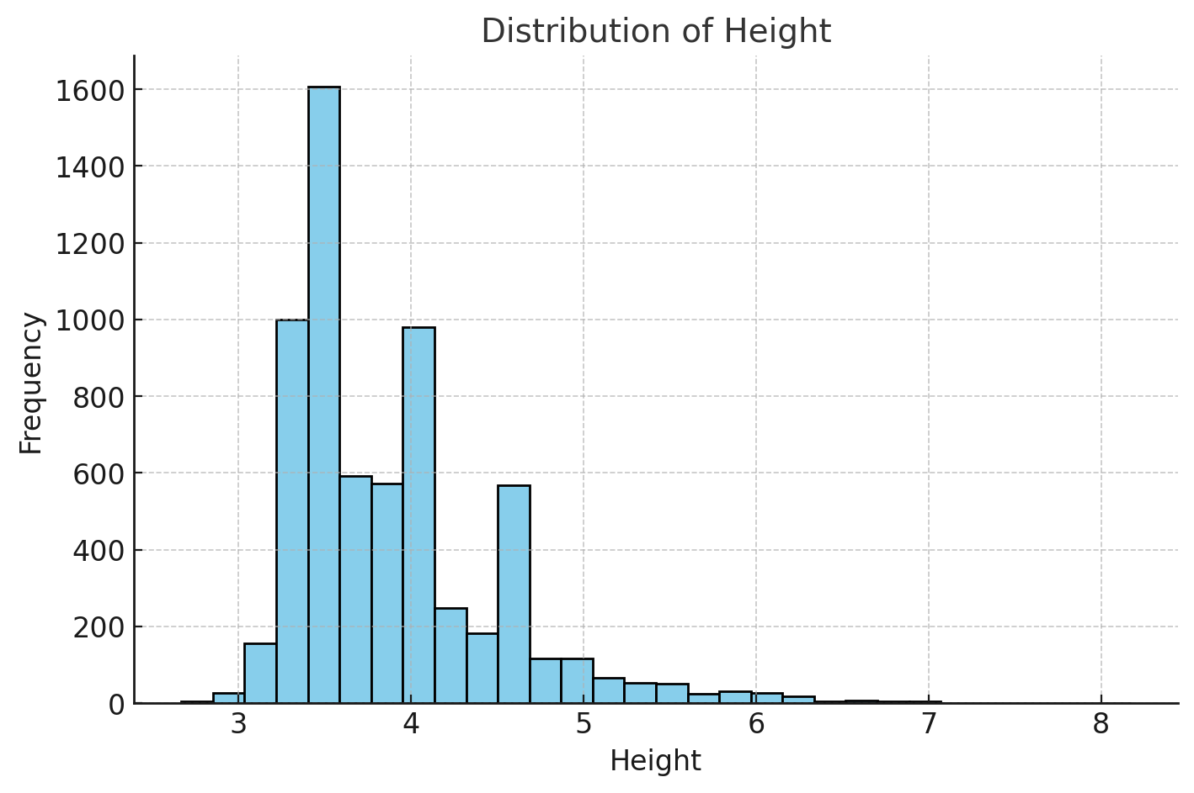
Distribution of Height
FIG. 7
Distribution of Height: Height distributions show peaks around 3–4 mm, indicating standard proportions for most diamonds. Very tall or shallow diamonds are rare.

Slide 15
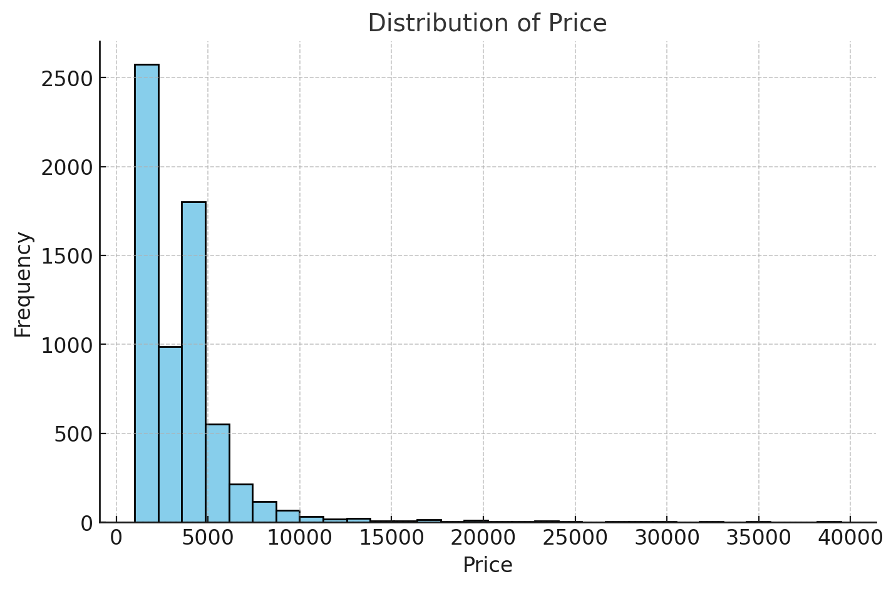
Distribution of Price
FIG. 8
Distribution of Price: The price distribution is highly skewed, with most diamonds priced below $5,000. A smaller number of diamonds are much more expensive, reaching up to $40,000.

Slide 16
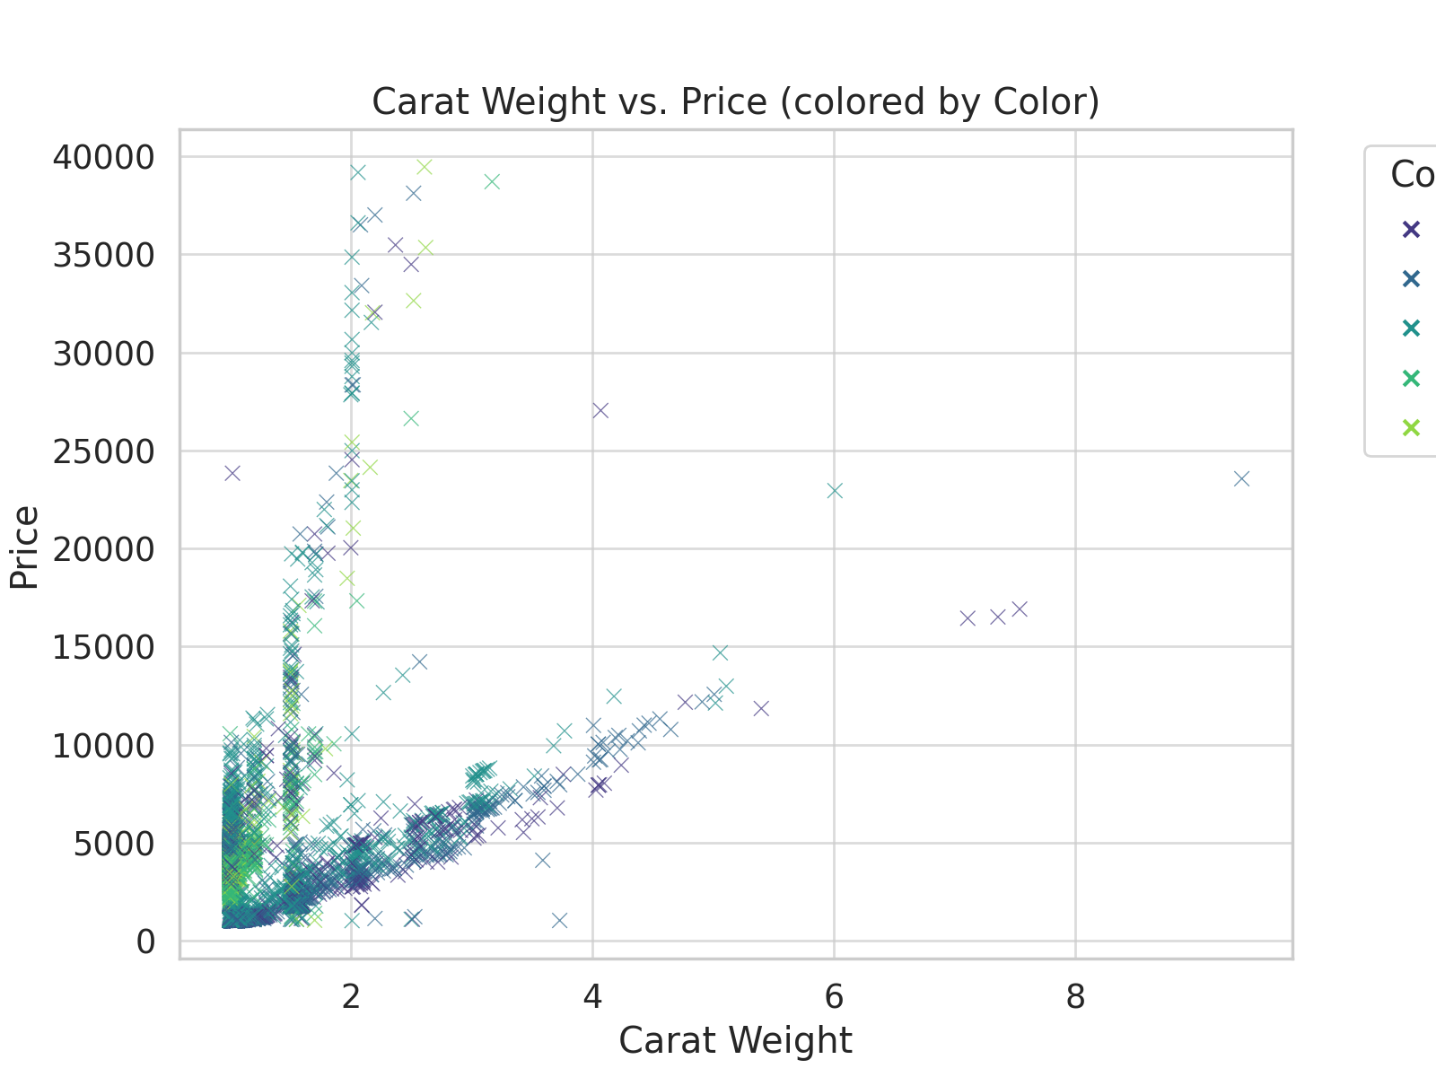
Scatter Plot: Carat Weight vs. Price
FIG. 9

Slide 17
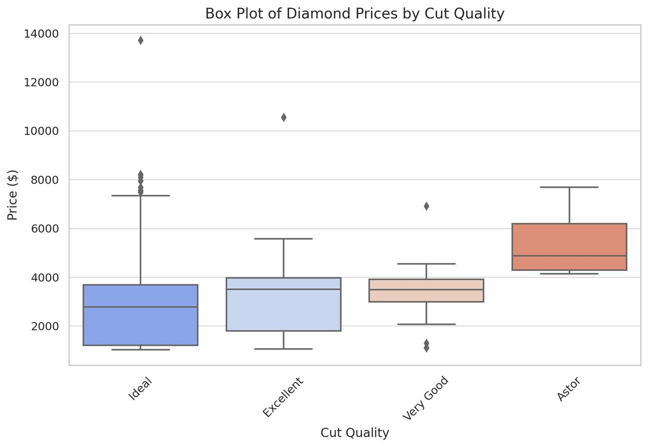
BOX PLOT
FIG. 10
Displays the distribution of diamond prices across different Cut categories.
box plot of diamond prices by Cut quality. It shows the price distribution for different cut grades, highlighting the median, quartiles, and outliers. The spread of prices varies significantly across cuts.

Slide 18
Observations
Positive Correlation: The plot shows that as the carat weight increases, the price tends to increase as well. This makes sense because larger diamonds are generally more valuable.
Price Variability: For smaller carat weights (e.g., less than 2), there is significant variability in price, suggesting that other factors like quality, cut, or color also influence price.
Outliers: A few data points are scattered far above or beyond the general trend, indicating unusually priced diamonds for their carat weight.
Color Influence: The clustering of colors suggests that the color category might subtly affect price, but it's harder to discern specific patterns without deeper analysis.

Slide 19
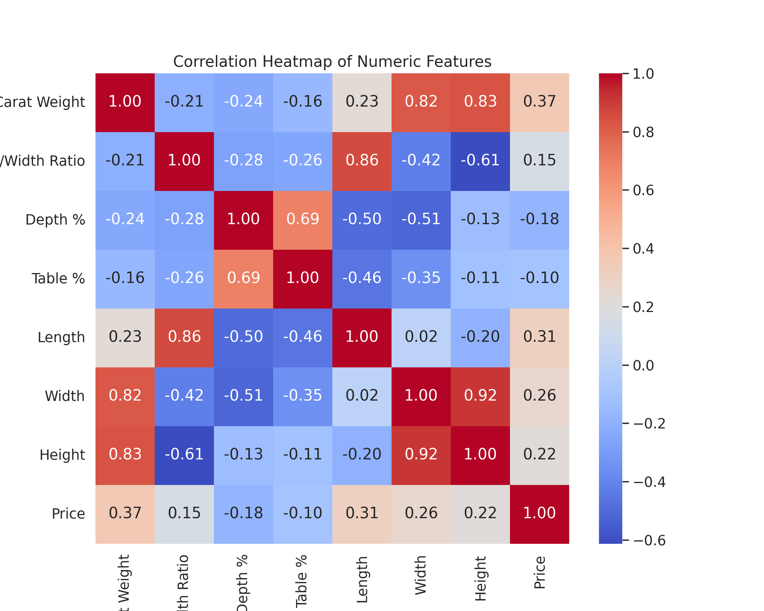
Correlation Heatmap
FIG. 12

Slide 20
Correlation Analysis
Highlights from the heatmap:
There is a strong correlation between Carat Weight and Price.
There is a weak correlation between Depth % and Price.
There is Relationships between dimensions (Length, Width, Height).

Slide 21
Key Takeaways
1. Price strongly depends on Carat Weight.
2. Significant variability in numeric distributions.
3. There is a strong inter-relationships between dimensions and Price.

Slide 22
Thank You!

